Slide 1
PHOTO EDITOR
BY:
B.ROHITH REDDY
192011221

Slide 2
PROJECT INCLUDE
Introduction (Appium & Android Studio)
Objective
Applications used
Code Implementation
Appium Testing
Outcome

Slide 3
ABSTRACT
Install Android Studio , IntelliJ and Appium Softwares.
Develop Photo Editor Application in Android Studio.
Open Unit Converter in Emulator.
Give Desired Capabilities in Appium Server.
Get the Java code for Testing.
Paste the code in IntelliJ IDE.
Run the code and Test the Conversions and Parameters

Slide 4
INTRODUCTION
Open source Automation tool.
Automation Framework.
Automates different types of mobile applications testing.
It can test web , Native and Hybrid application.It
supports multiple programming languages.
(Java , python , ruby and many more )
5.It works on Emulator as well as Real Devices.
Task 1
Task 2
Task 3

Slide 5
Two Content Layout with SmartArt
Android Studio
It is Integrated development Environment.
It has fast Emulator for App Testing.
Used to Develop applications for Android devices.
It is an open source software
Task 1
Task 2
Task 3

Slide 6
OBJECTIVES
To Develop Photo Editor application using Android Studio and Run the application using Android Studio Emulator.
Installing The Appium Software and Testing the Unit Converter Application using the Appium Software.

Slide 7
PROPOSED WORK
To Develop Scientific Unit converter Application.
Run the Application using Android Studio Emulator.
Test the Application in Appium Software.
Appium will Automate the Testing of Application.
Appium interacts with the Application and finds the positive and Negative Outcomes.
Different Strategies Will be tested using Appium.

Slide 8
TEST CASES
APP LAUNCH
USER NAME
EDIT OR CAMERA
CROP
FILTERS
SAVE
PRINT
PERFORMANCE

Slide 9



APPLICATIONS USED

Slide 10
Install Android Studio
Install Intellij
Open Appium Software
Edit the image(Testing)
Open photo edit(Testing)
Select type(Testing)
Install Appium
Develop App in Android Studio
Open App in Emulator
Automate the Testing
Positive and Negative Outcomes
Testing Completed
DATAFLOW
diagram

Slide 11
TEST CASE OUTCOME
APP LAUNCH - POSITIVE
USER NAME - POSITIVE
EDIT OR CAMERA - POSITIVE
CROP - POSITIVE
FILTERS - POSITIVE
SAVE - POSITIVE
PRINT - POSITIVE
PERFORMANCE - POSITIVE

Slide 12
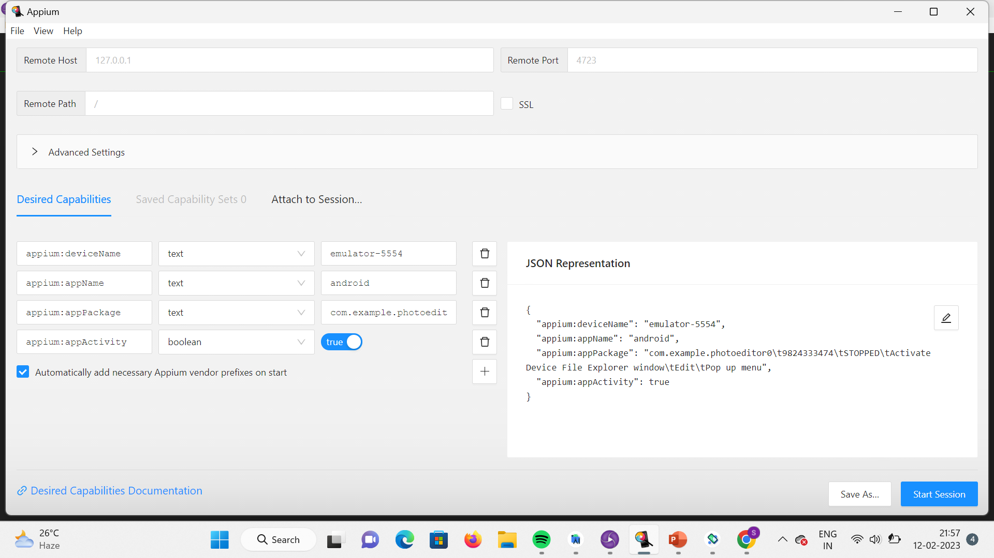
Give the Desired Capabilities in Appium Inspector.
It will start the session and gives you java code to start testing.
Paste the code in IntelliJ IDE and Start the Testing.
APPIUM INSPECTOR (DESIRED CAPABILITIES)

Slide 13
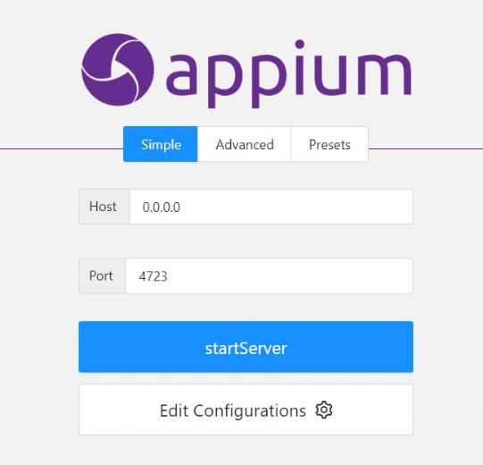
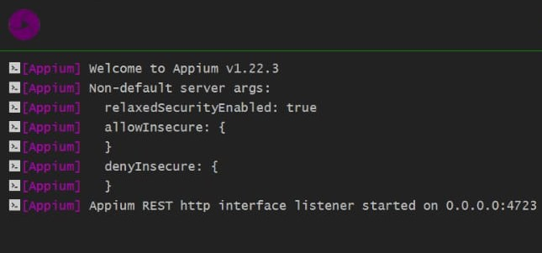
APPIUM SERVER

Slide 14
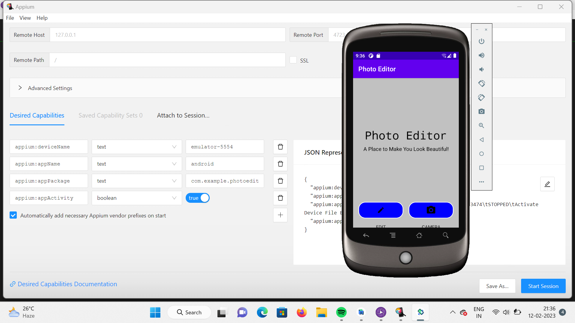
TESTING OUTPUT

Slide 15
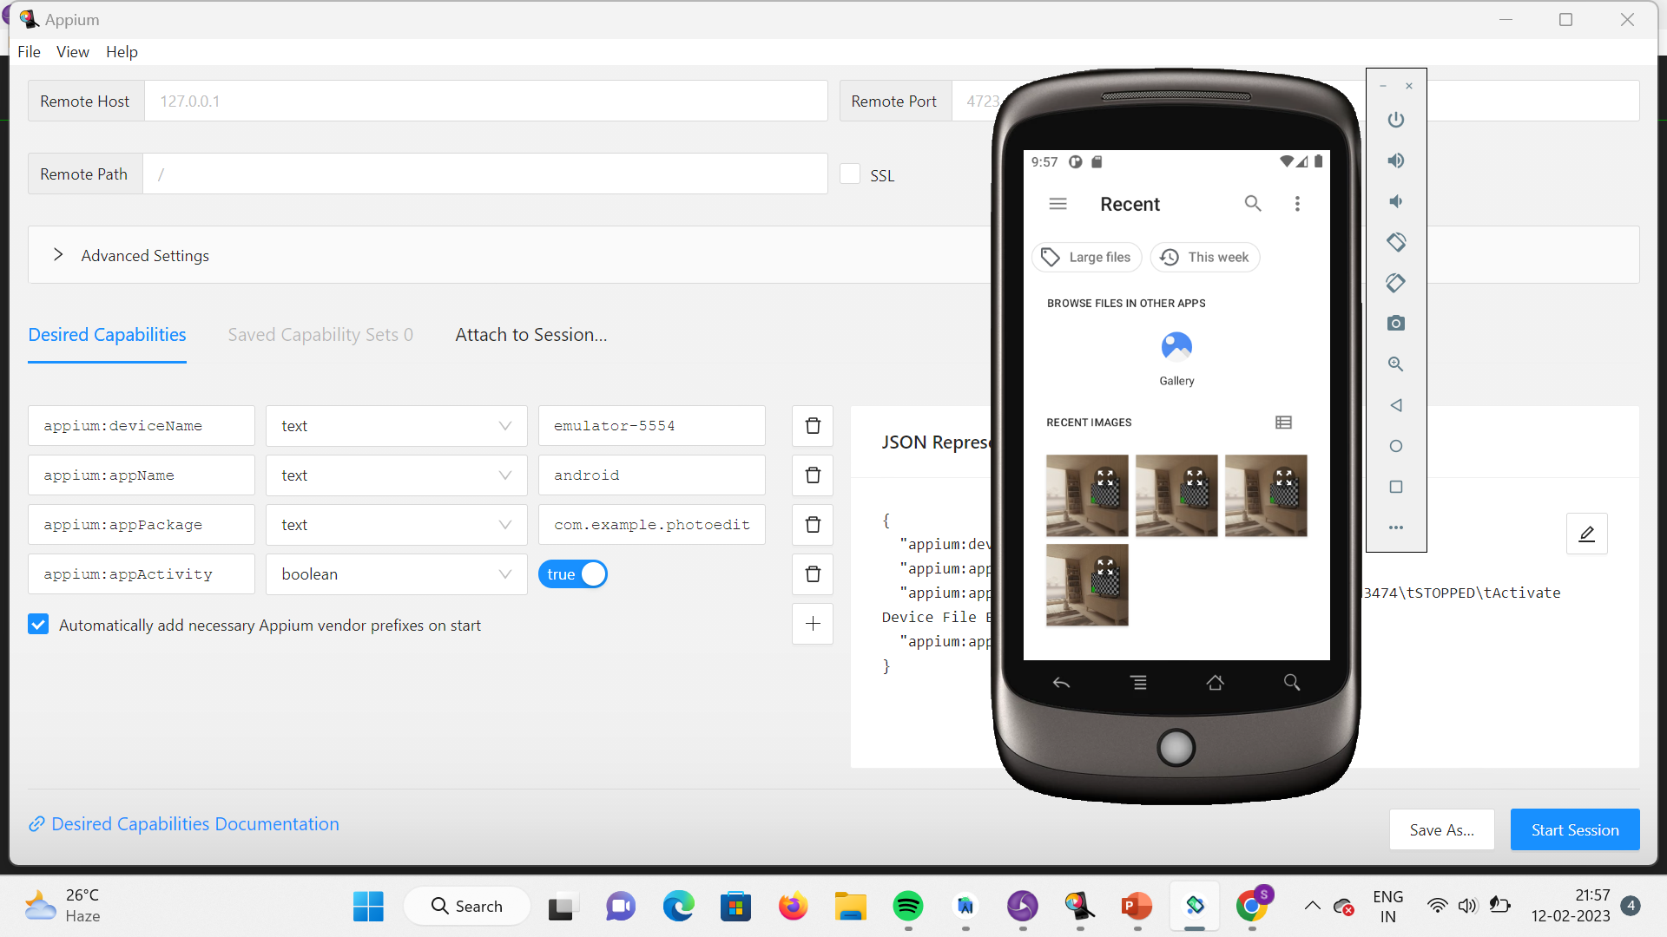
TESTING OUTPUT

Slide 16
THANK
YOU

